Slide 1
CS97: INTRODUCTION TO DATA SCIENCE
09: Decision Tree
Instructor: Shichang Zhang
shichang@ucla.edu

Slide 2
Outline
Motivation
Decision Trees
Splitting Criteria
Stopping Conditions & Pruning
Regression Trees
Random Forrest

Slide 3
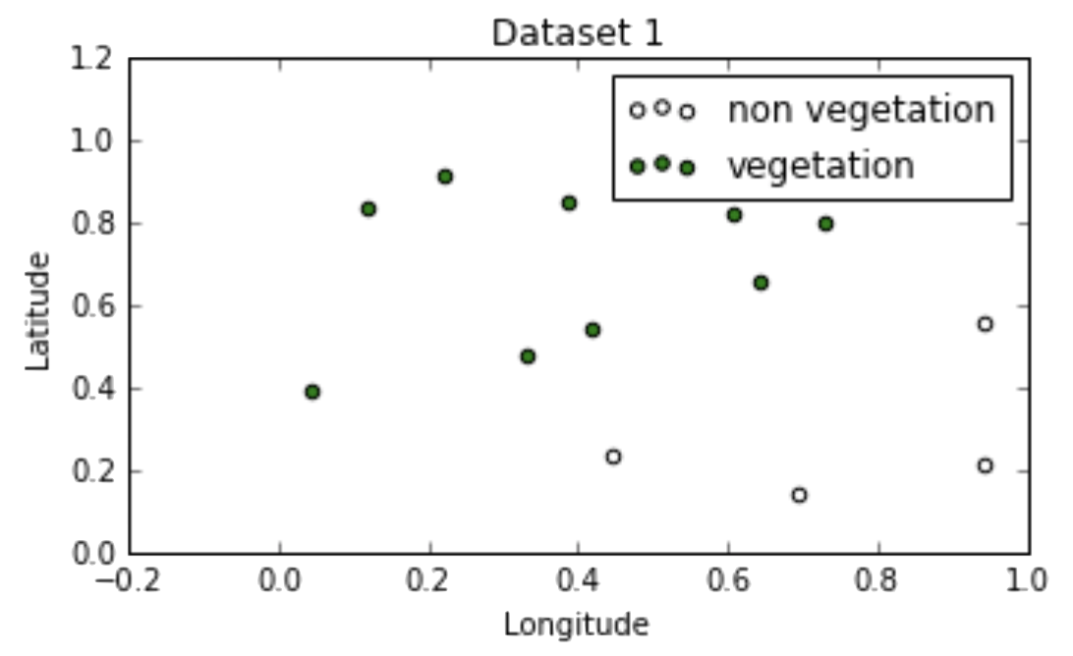
Geometry of Data
Recall:
logistic regression for building classification boundaries works best when:
the classes are well-separated (linearly) in the feature space
have a “nice geometry” to the classification boundary

Slide 4
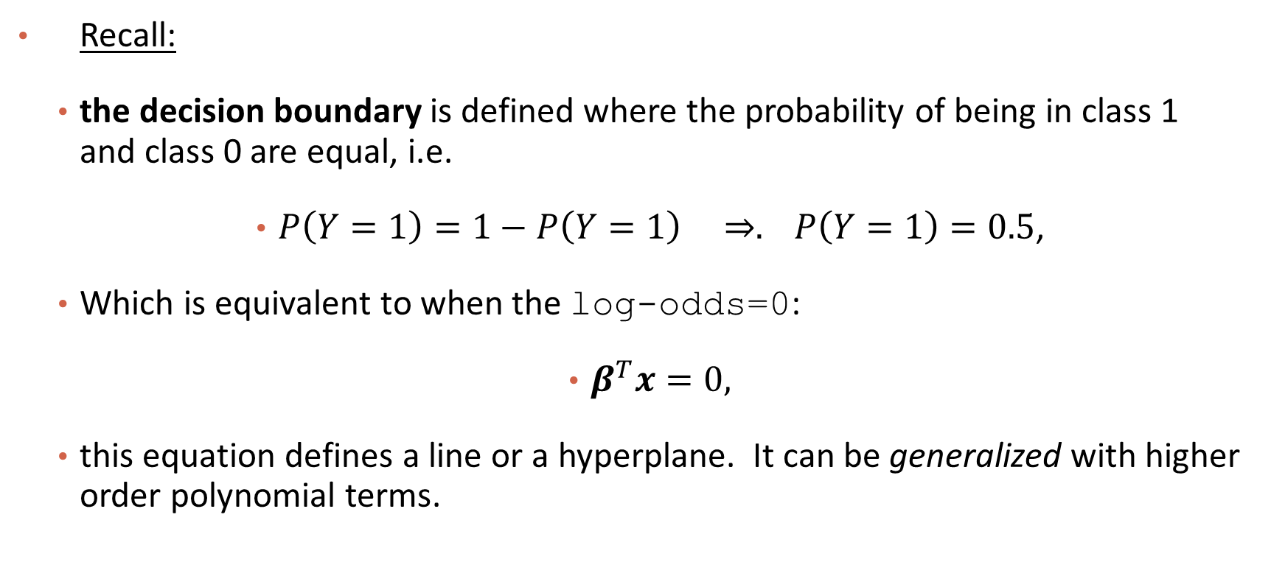
Geometry of Data

Slide 5
Geometry of Data
The decision boundary of logistic regression

Slide 6
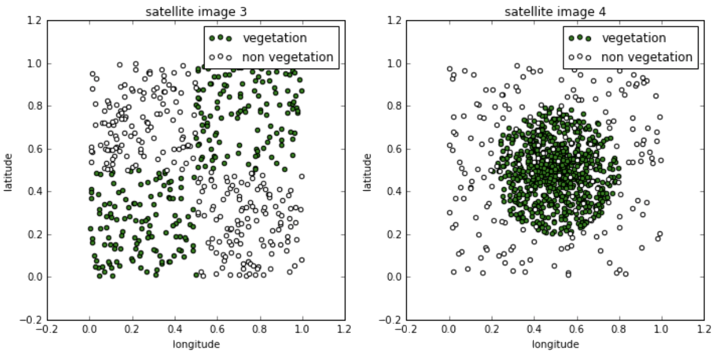
Geometry of Data
Question: How about these?

Slide 7
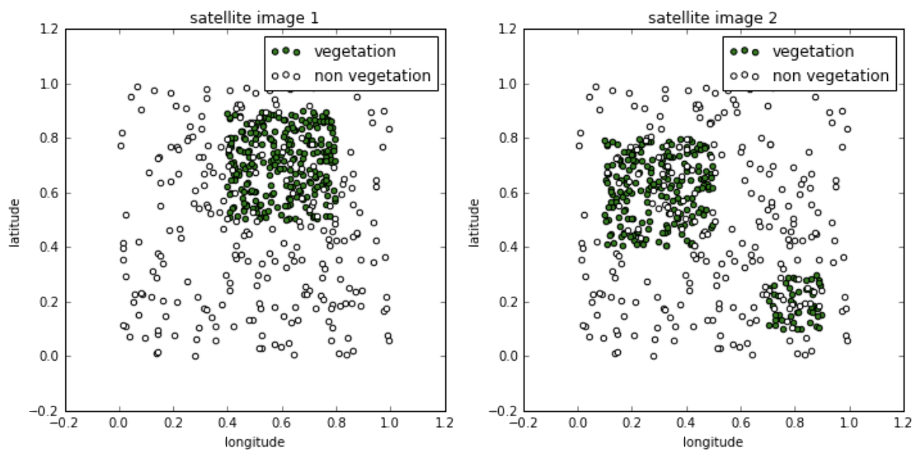
Geometry of Data
Question: Or these?

Slide 8
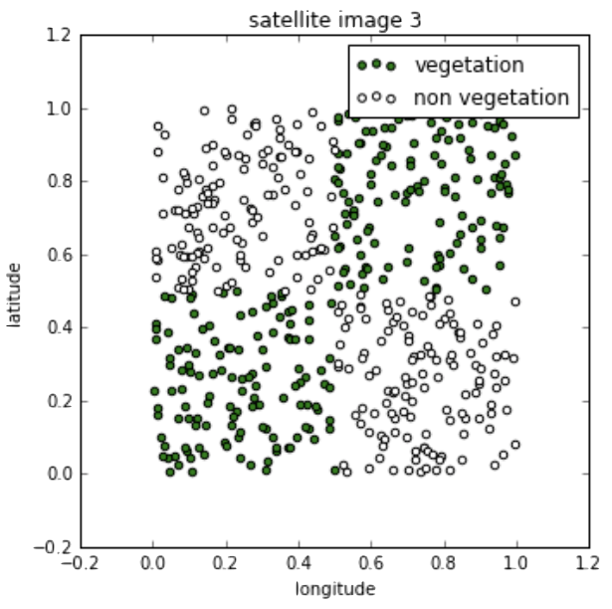
Geometry of Data
The classes are still well-separated, but the optimal decision boundaries cannot easily be described by single equations:

Slide 9
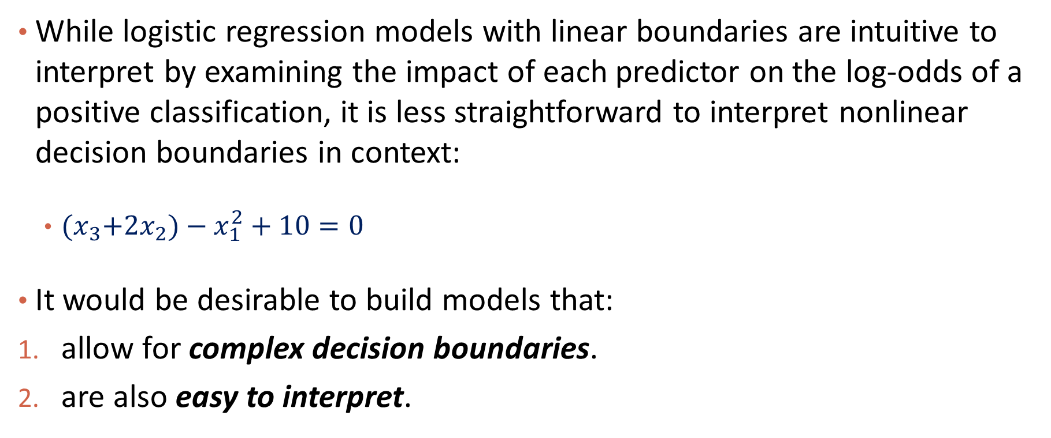
Geometry of Data

Slide 10
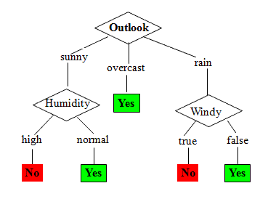
Decision Trees
People have long been using interpretable models for differentiating between classes of objects and phenomena:
Go play soccer?
Notes:
Greasy matherial

Slide 11
Decision Trees
It turns out that the simple flow charts can be formulated as mathematical models for classification and these models have the properties we desire; they are:
interpretable by humans
have sufficiently complex decision boundaries
the decision boundaries are locally linear, each component of the decision boundary is simple to describe mathematically.

Slide 12
Outline
Motivation
Decision Trees
Splitting Criteria
Stopping Conditions & Pruning
Regression Trees
Random Forrest

Slide 13
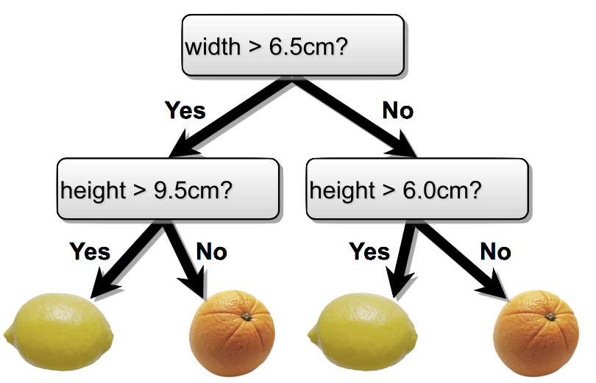
Tree-based Models
Use trees to partition the data into different regions and make predictions
Root node
Internal nodes
Leaf nodes

Slide 14
The Geometry of Flow Charts
Flow charts whose graph is a tree (connected and no cycles) represents a model called a decision tree.
Formally, a decision tree model is one in which the final outcome of the model is based on a series of comparisons of the values of predictors against threshold values.
In a graphical representation (flow chart),
the internal nodes of the tree represent attribute to test.
branching in the next level is determined by attribute value (e.g., yes/no).
terminal leaf nodes represent class assignments.
What fruit is this?
Notes:
Change this to interactive

Slide 15
Easy to Interpret
A path from root to a leaf node corresponds to a rule
E.g., if width > 6.5 and height > 9.5
then target value= lemon

Slide 16
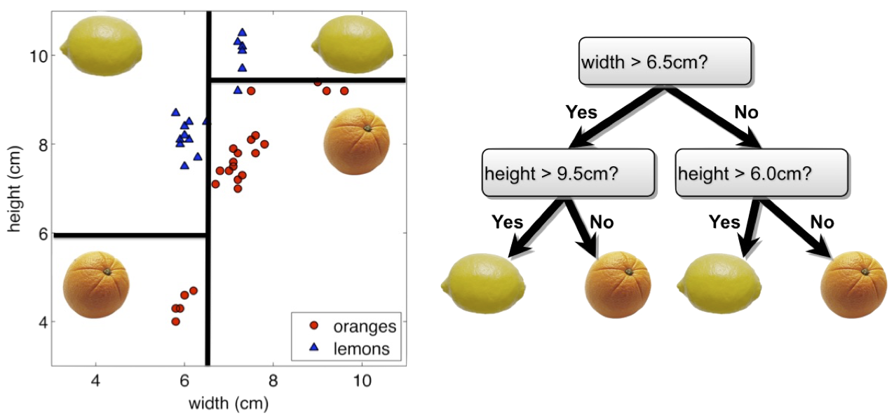
The Geometry of Flow Charts
Every flow chart tree corresponds to a partition of the feature space by axis aligned lines or (hyper) planes. Conversely, every such partition can be written as a flow chart tree.

Slide 17
The Geometry of Flow Charts
Each comparison and branching represents splitting a region in the feature space on a single feature. Typically, at each iteration, we split once along one dimension (one predictor).

Slide 18
Tree-based Models
Branching beyond binary and numerical
Buys Xbox or not?
age?
<=30
>40
31 - 40
student?
yes
credit rating?
no
yes
excellent
fair
no
yes
yes
no

Slide 19
Numerical vs. Categorical
Numerical variable
Use threshold to partition data
Categorical variable
Use the possible value to partition the data

Slide 20



Please download and install the Slido app on all computers you use
Audience Q&A Session
ⓘ Start presenting to display the audience questions on this slide.

Slide 21
Learning the Model
Given a training set, learning a decision tree model for binary classification means:
producing an optimal partition of the features with axis-aligned linear boundaries (pick both the feature and split point),
each region is predicted to have a class label based on the majority class of the training points in that region when performing prediction.

Slide 22
Learning the Model
Learning the smallest ‘optimal’ decision tree for any given set of data is very hard. Instead, we will seek a reasonably model using a greedy algorithm (similar to forward selection).
Start with an empty decision tree (undivided feature space)
Choose the ‘optimal’ predictor on which to split and choose the ‘optimal’ threshold value for splitting.
Recurse on each new node until stopping condition is met
Now, we need only define our splitting criterion and stopping condition.

Slide 23
Outline
Motivation
Decision Trees
Splitting Criteria
Stopping Conditions & Pruning
Regression Trees
Random Forrest

Slide 24
Guideline of Splitting
While there is no perfect way to define an optimal split, there are some common sensical guidelines for every splitting criterion:
the regions in the features should grow progressively more pure with the number of splits. That is, we should see each region ‘specialize’ towards a single class.
we shouldn’t end up with empty regions - regions containing no training points.

Slide 25
Guideline of Splitting

Slide 26
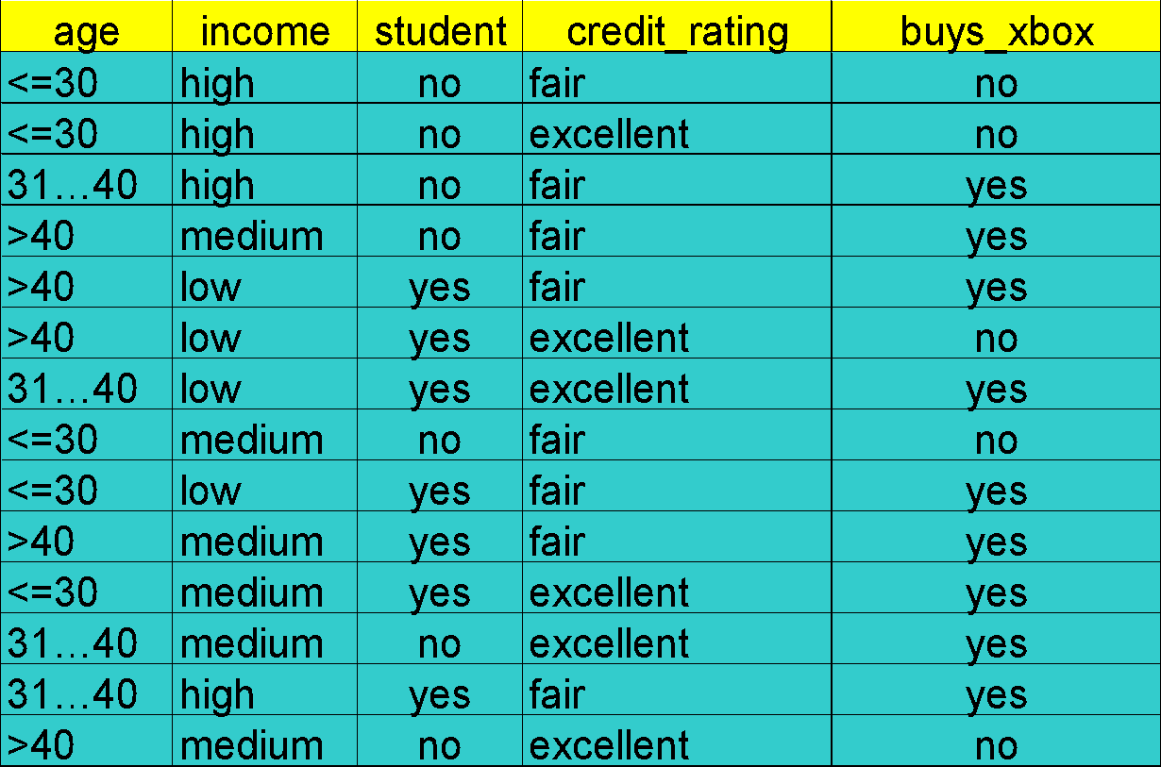
Example

Slide 27
Which attribute to choose?
Student
Credit_Rating
Yes
No
Excellent
Fair
Yes
Yes
Yes
Yes
No
Yes
No
No
No
No
VS.
Yes
Yes
Yes
No
No
No
Yes
Yes
Yes
Yes
Yes
YesNo
No

Slide 28
Which attribute to choose?
Ages
Credit_Rating
<=30
31…40
>40
Excellent
Fair
Yes
Yes
No
No
No
Yes
Yes
Yes
Yes
Yes
Yes
Yes
No
No
VS.
Yes
Yes
Yes
No
No
No
Yes
Yes
Yes
Yes
Yes
YesNo
No

Slide 29
How to define purity of each region?
Classification error
Entropy

Slide 30
Example: calculate classification error
Ages
Credit_Rating
<=30
31…40
>40
Excellent
Fair
Yes
Yes
Yes
Yes
Yes
YesNo
No
Yes
Yes
No
No
No
Yes
Yes
Yes
Yes
Yes
Yes
Yes
No
No
VS.
Yes
Yes
Yes
No
No
No
Suppose that in each sub-region, we use the majority label as the predicted class label.
Q1: for Credit rating split, what’s the classification error in each region?

Slide 31
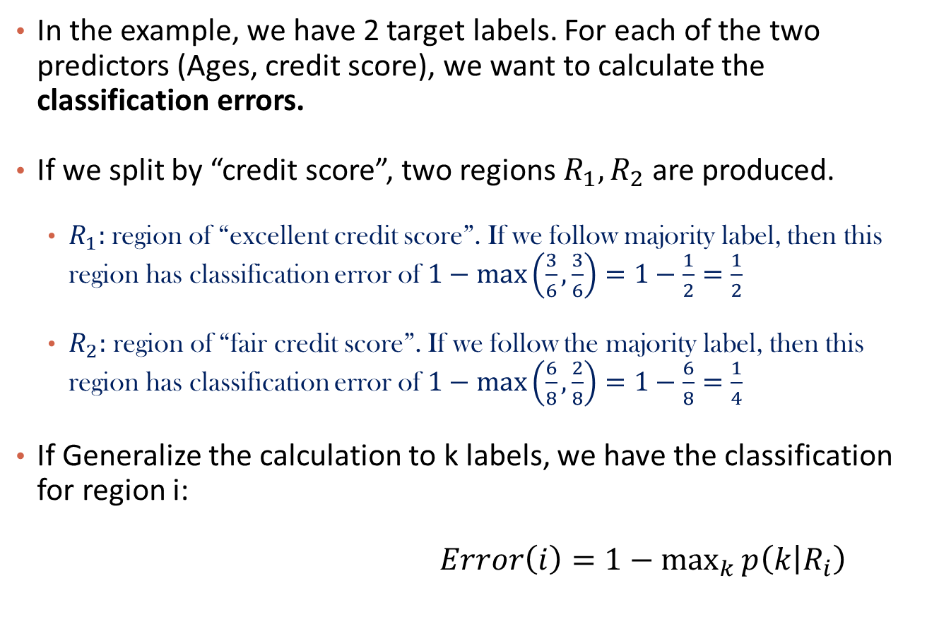
Classification Error
Credit_Rating
Excellent
Fair
Yes
Yes
Yes
Yes
Yes
YesNo
No
Yes
Yes
Yes
No
No
No

Slide 32
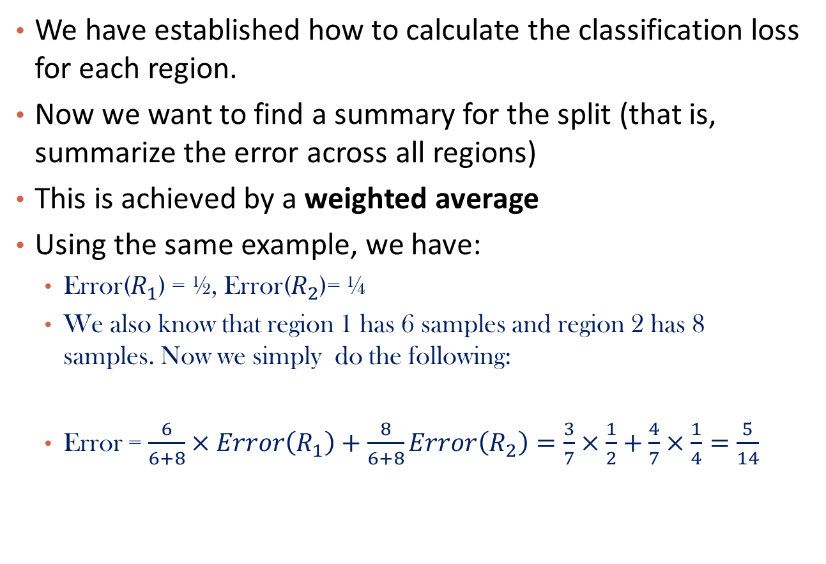
Overall classification loss
Credit_Rating
Excellent
Fair
Yes
Yes
Yes
Yes
Yes
YesNo
No
Yes
Yes
Yes
No
No
No

Slide 33
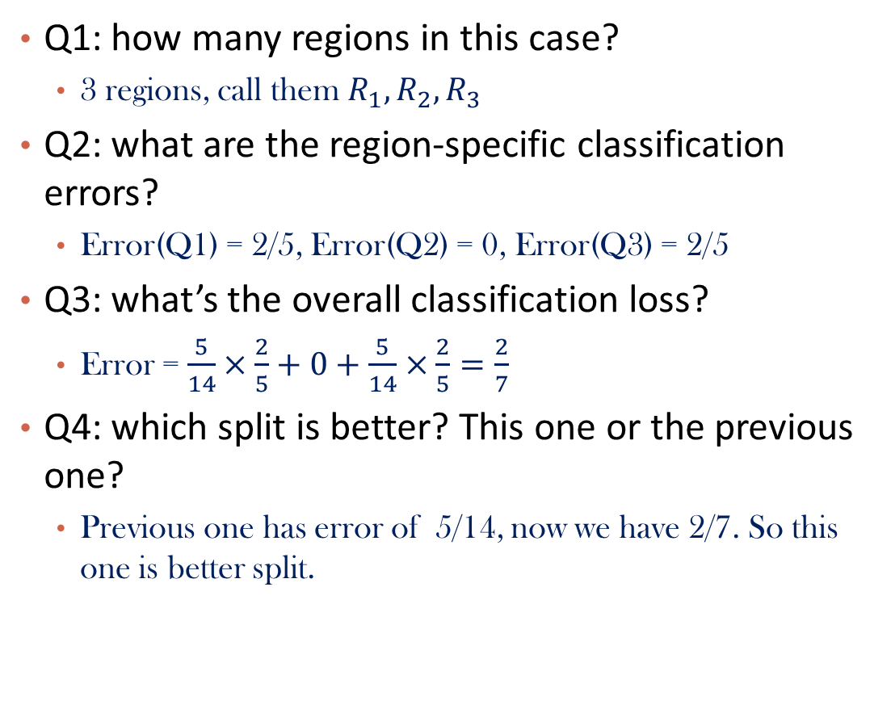
Let’s also see how the other split works
Ages
<=30
31…40
>40
Yes
Yes
No
No
No
Yes
Yes
Yes
Yes
Yes
Yes
Yes
No
No

Slide 34
Please download and install the Slido app on all computers you use
Audience Q&A Session
ⓘ Start presenting to display the audience questions on this slide.

Slide 35
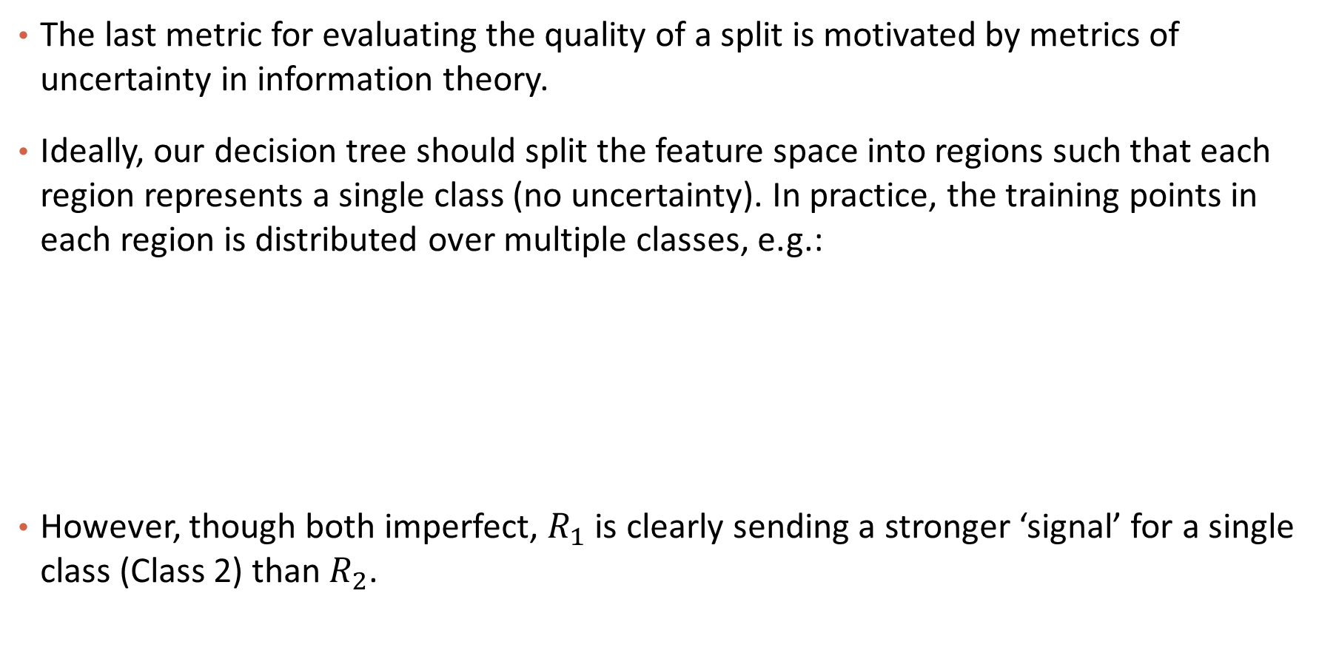
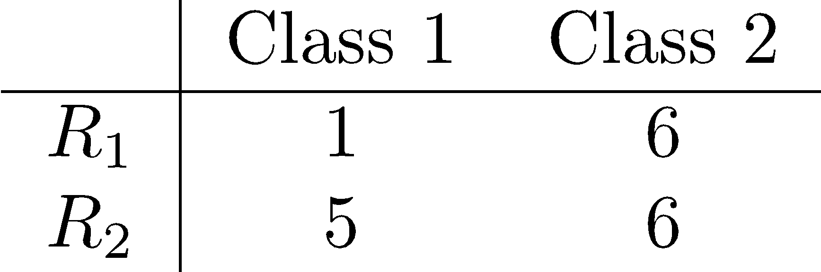
Information Theory

Slide 36
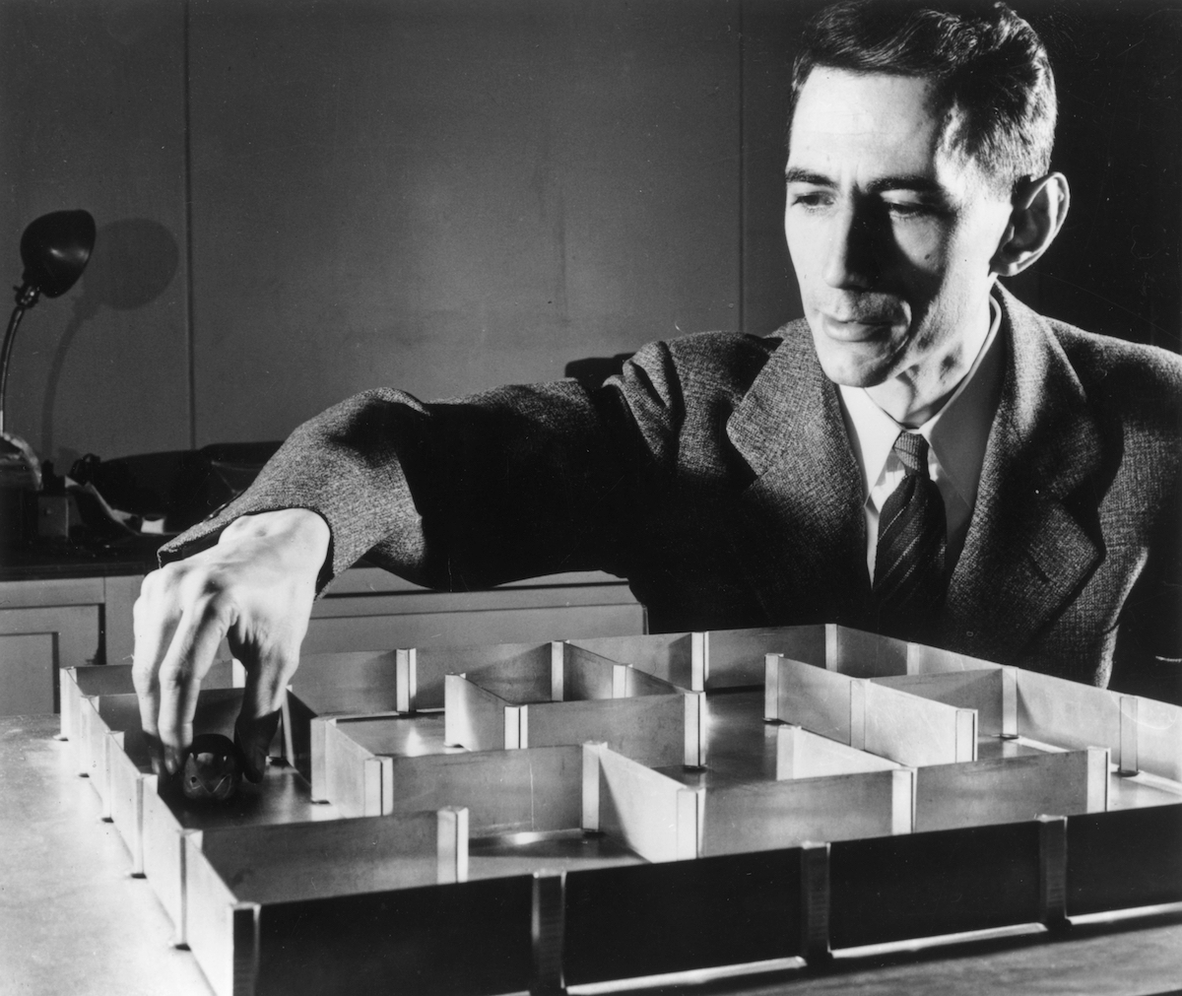
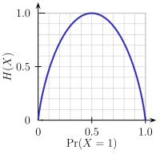
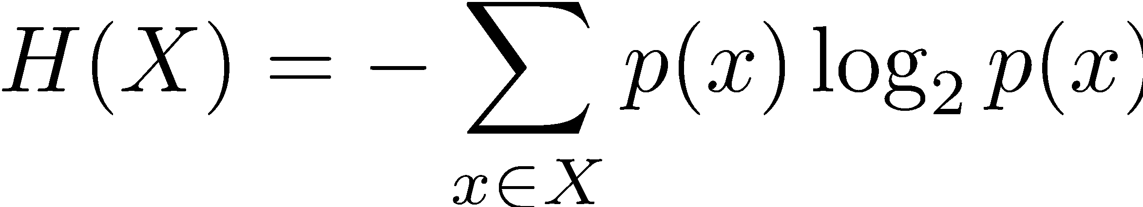
Information Theory
One way to quantify the strength of a signal in a particular region is to analyze the distribution of classes within the region. We compute the entropy of this distribution (also known as Shannon Entropy).
For a discrete distribution, the entropy is computed by:
Claude Shannon
(1916 - 2001)
Notes:
the expected value of the logarithm of the probability (inverse)
average of log(1/𝑝)log(1/p)
We can call log(1/𝑝)log(1/p) information
- logarithm of product is sum of logarithms
- logarithm is to make it growing linearly with system size and "behaving like information"

Slide 37
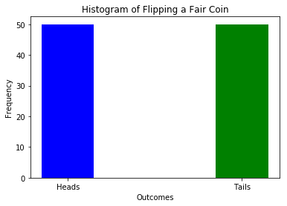
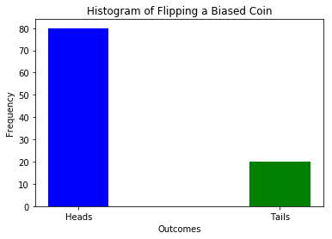
Entropy and distribution
Higher entropy means the distribution is uniform-like (flat histogram) and thus values sampled from it are ‘less predictable’ (all possible values are equally probable).
Lower entropy means the distribution has more defined peaks and valleys and thus values sampled from it are ‘more predictable’ (values around the peaks are more probable).

Slide 38
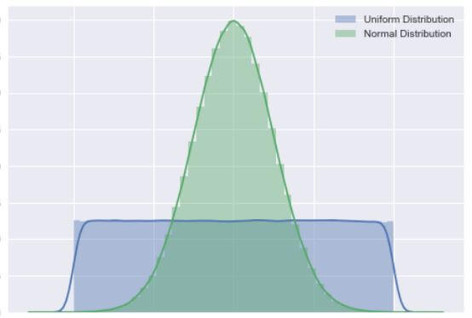
Entropy and distribution
Higher entropy means the distribution is uniform-like (flat histogram) and thus values sampled from it are ‘less predictable’ (all possible values are equally probable).
Lower entropy means the distribution has more defined peaks and valleys and thus values sampled from it are ‘more predictable’ (values around the peaks are more probable).

Slide 39
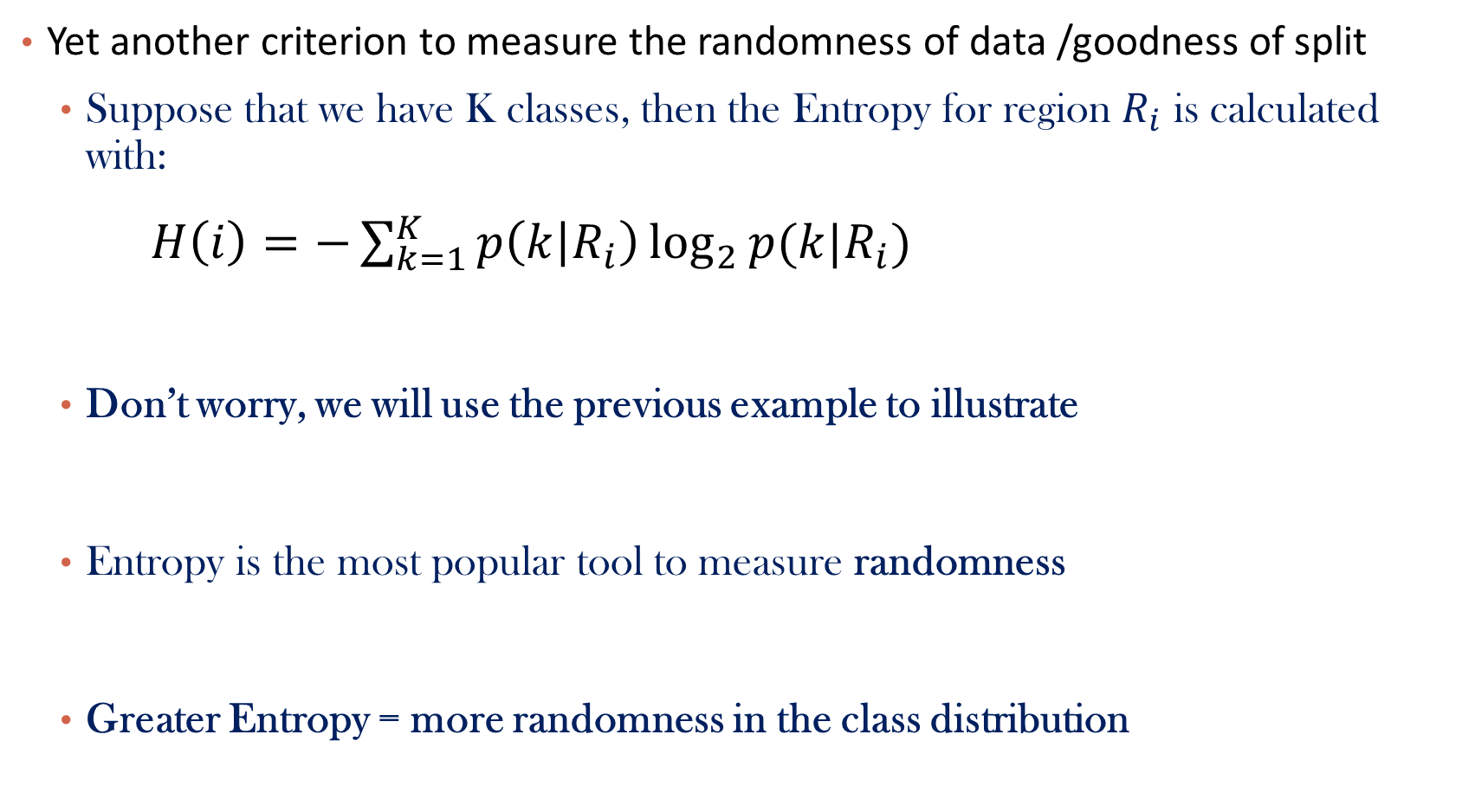
Entropy

Slide 40
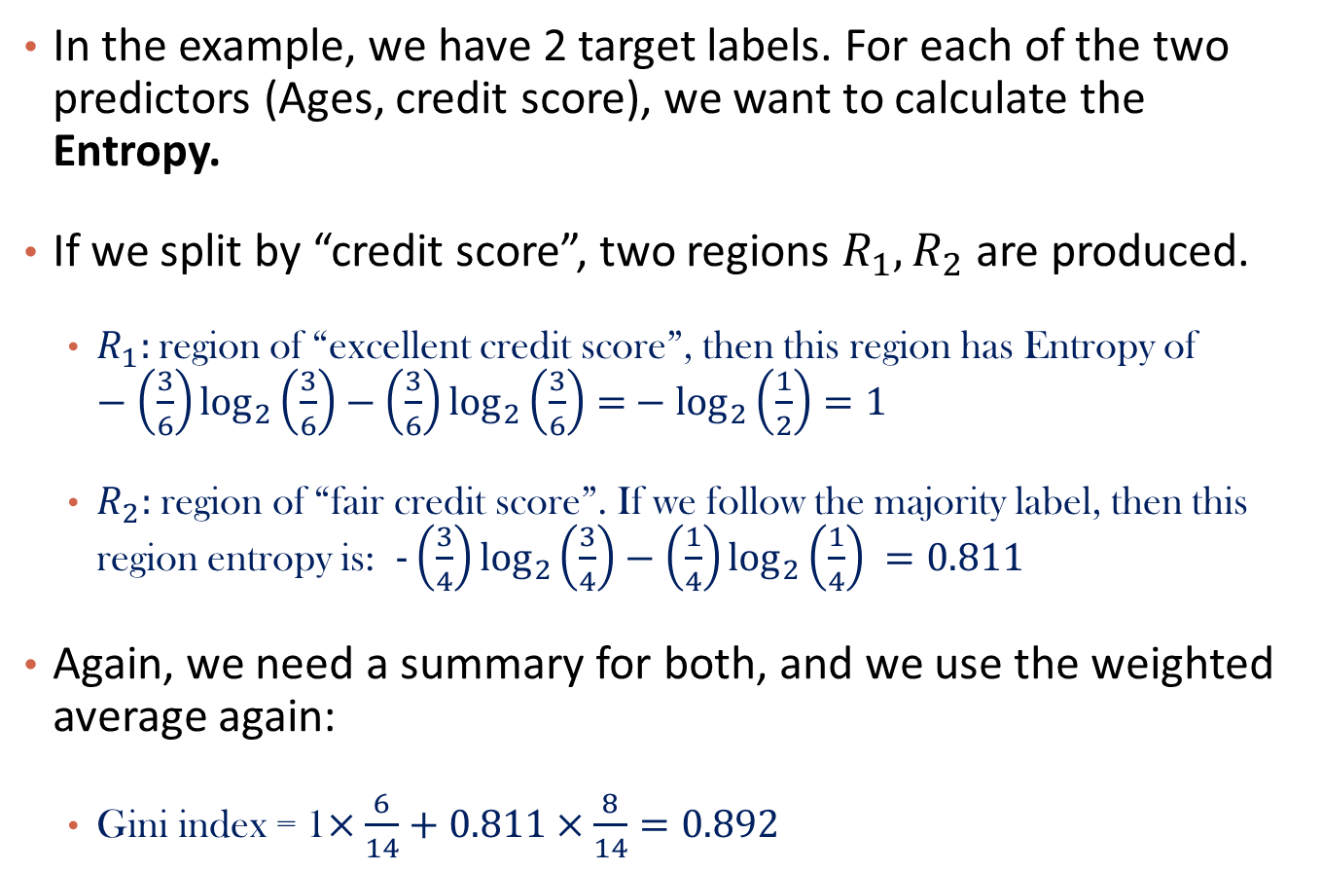
Entropy Calculation
Credit_Rating
Excellent
Fair
Yes
Yes
Yes
Yes
Yes
YesNo
No
Yes
Yes
Yes
No
No
No
Entropy

Slide 41
Let’s also see how the other split works
Q1: what are the region-specific Entropy?
Entropy(Q1) =
Entropy(Q2) =
Entropy(Q3) =
Q2: what’s the overall Entropy?
Entropy =
Q3: which split is better? This one or the previous one?
We want less uncertainty after the split!
Ages
<=30
31…40
>40
Yes
Yes
No
No
No
Yes
Yes
Yes
Yes
Yes
Yes
Yes
No
No

Slide 42
Let’s also see how the other split works
Q1: what are the region-specific Entropy?
Entropy(Q1) = 0.97
Entropy(Q2) = 0
Entropy(Q3) = 0.97
Q2: what’s the overall Entropy?
Entropy = 0.69
Q3: which split is better? This one or the previous one?
We want less uncertainty after the split!
Ages
<=30
31…40
>40
Yes
Yes
No
No
No
Yes
Yes
Yes
Yes
Yes
Yes
Yes
No
No

Slide 43
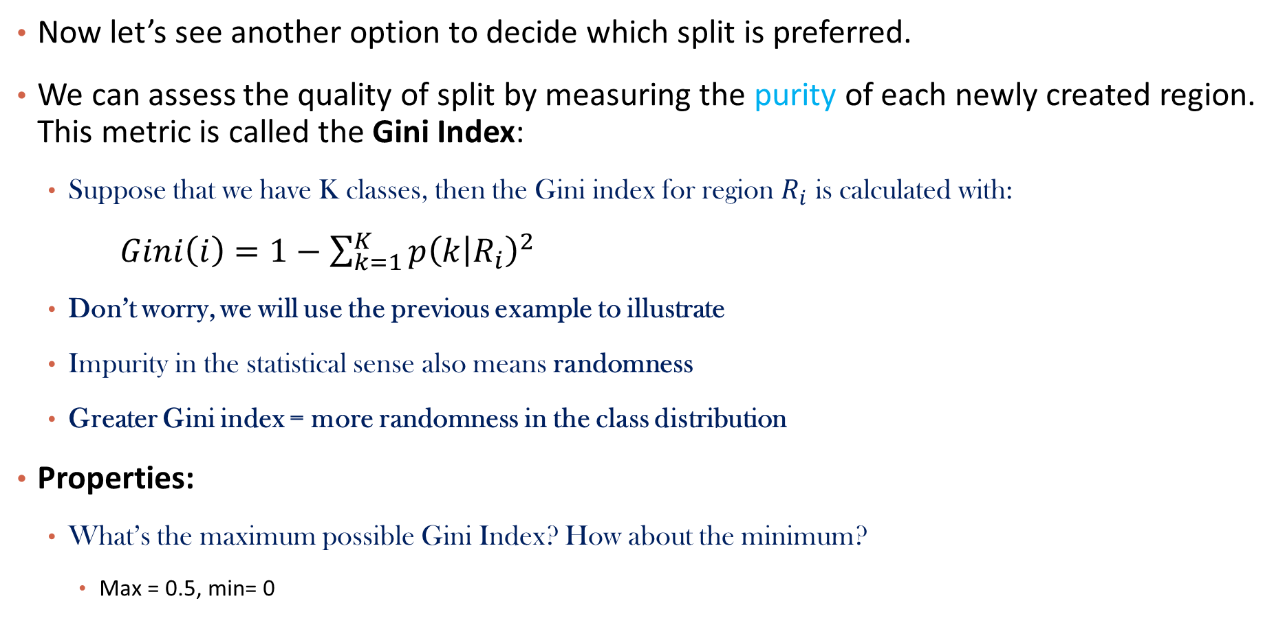
Gini Index
Notes:
“measure how often a randomly chosen element from the set would be incorrectly labeled”. A gini score of 0 is the most pure score possible. (max=0.5)
Entropy and Gini are more sensitive to changes in the node probabilities than the misclassification error rate. (square of small p becomes smaller)
Makes it differentiable

Slide 44
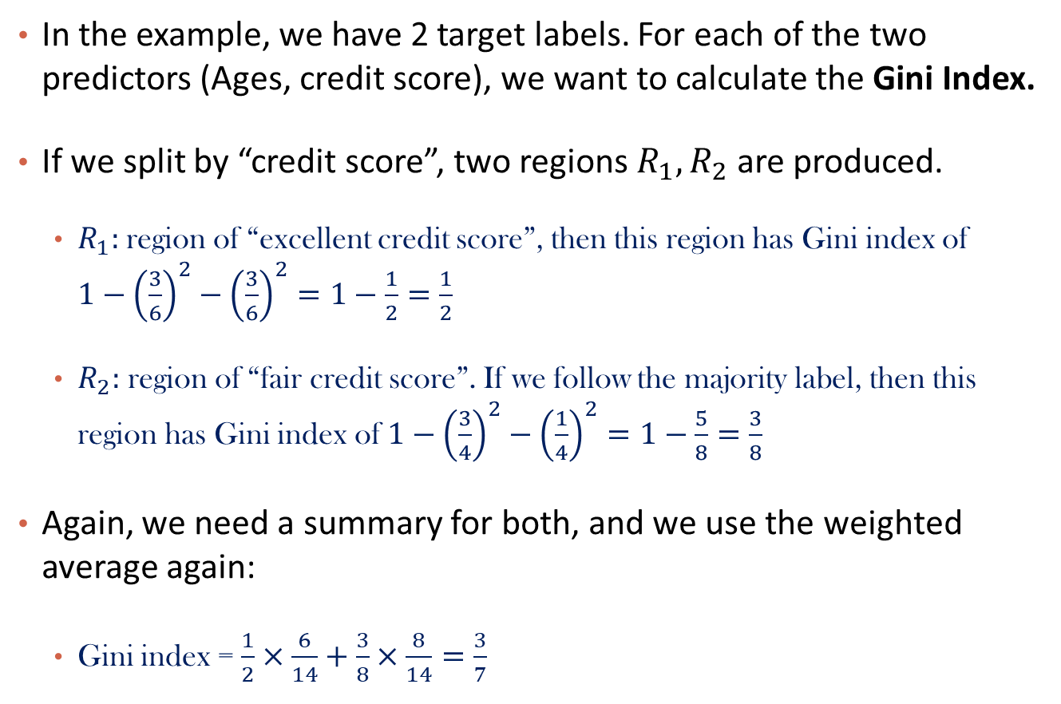
Gini Index Calculation
Credit_Rating
Excellent
Fair
Yes
Yes
Yes
Yes
Yes
YesNo
No
Yes
Yes
Yes
No
No
No

Slide 45
Let’s also see how the other split works
Q1: what are the region-specific Gini Index?
Gini(Q1) =
Gini(Q2) =
Gini(Q3) =
Q2: what’s the overall Gini Index?
Gini =
Q3: which split is better? This one or the previous one?
Previous one has Gini index of 3/7
This one has
We want less impurity in the data split!
Ages
<=30
31…40
>40
Yes
Yes
No
No
No
Yes
Yes
Yes
Yes
Yes
Yes
Yes
No
No

Slide 46
Comparison of Criteria
Recall our intuitive guidelines for splitting criteria, which of the criteria fits our guideline the best?
To note that entropy penalizes impurity the most is not to say that it is the best splitting criteria. For one, a model with purer leaf nodes on a training set may not perform better on the testing test.
Another factor to consider is the size of the tree (i.e. model complexity) each criteria tends to promote.
To compare different decision tree models, we need to first discuss stopping conditions.
Notes:
Gin:
- Favors larger partitions.
- Uses squared proportion of classes.
- Perfectly classified, Gini Index would be zero.
- Evenly distributed would be 1 – (1/# Classes).
- You want a variable split that has a low Gini Index.
Entropy:
- Favors splits with small counts but many unique values.
- Weights probability of class by log(base=2) of the class probability
- A smaller value of Entropy is better. That makes the difference between the parent node’s entropy larger.
- Information Gain is the Entropy of the parent node minus the entropy of the child nodes.

Slide 47
Outline
Motivation
Decision Trees
Splitting Criteria
Stopping Conditions & Pruning
Regression Trees
Random Forrest

Slide 48
Variance vs Bias
If we don’t terminate the decision tree learning algorithm manually, the tree will continue to grow until each region defined by the model possibly contains exactly one training point (and the model attains 100% training accuracy).
To prevent this from happening, we can simply stop the algorithm at a particular depth.
But how do we determine the appropriate depth?

Slide 49
Variance vs Bias
We make some observations about our models:
(High Bias) A tree of low depth is not a good fit for the training data - it’s unable to capture the nonlinear boundary separating the two classes.
(Low Bias) With an extremely high depth, we can obtain a model that correctly classifies all points on the boundary (by zig-zagging around each point).
(Low Variance) The tree of low depth is robust to slight perturbations in the training data - the square carved out by the model is stable if you move the points a bit.
(High Variance) Trees of high depth are sensitive to perturbations in the training data, especially to changes in the boundary points.
Not surprisingly, complex trees have low bias (able to capture more complex geometry in the data) but high variance (can overfit). Complex trees are also harder to interpret and more computationally expensive to train.

Slide 50
Recall: Guideline of Splitting

Slide 51
Stopping Conditions
Common simple stopping conditions:
Don’t split a region if all instances in the region belong to the same class.
Don’t split a region if the number of instances in the sub-region will fall below pre-defined threshold (min_samples_leaf).
Don’t split a region if the total number of leaves in the tree will exceed pre-defined threshold.
The appropriate thresholds can be determined by evaluating the model on a held-out data set or, better yet, via cross-validation.

Slide 52
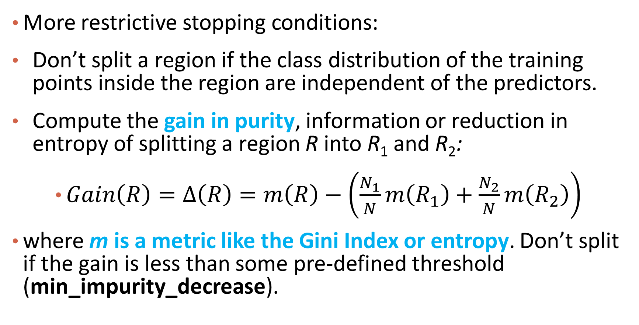
Stopping Conditions
More restrictive stopping conditions:
Compute the gain in purity of splitting a region R into R1​ and R2:
m is a metric like entropy. Don’t split if the gain is less than some pre-defined threshold (min_impurity_decrease).

Slide 53
Alternative to Using Stopping Conditions
What is the major issue with pre-specifying a stopping condition?
You may stop too early or stop too late.
How can we fix this issue?
Choose several stopping criterion (set minimal Gain(R) at various levels) and cross-validate which is the best.
What is an alternative approach to this issue?
Don’t stop. Instead prune back!

Slide 54
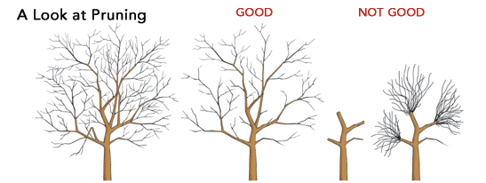
What is pruning?

Slide 55


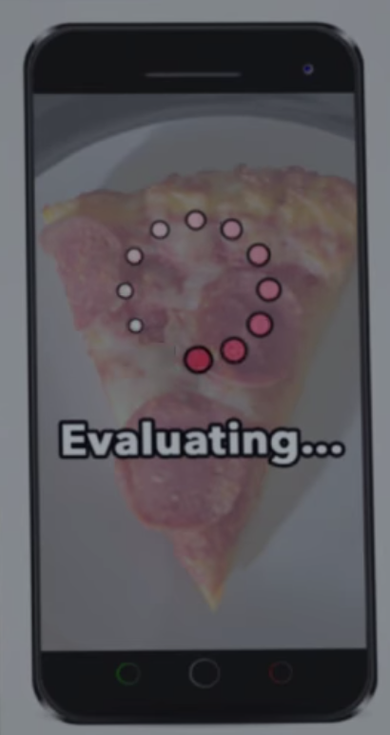

To Hot Dog or Not Hot Dog…

Slide 56
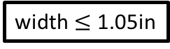
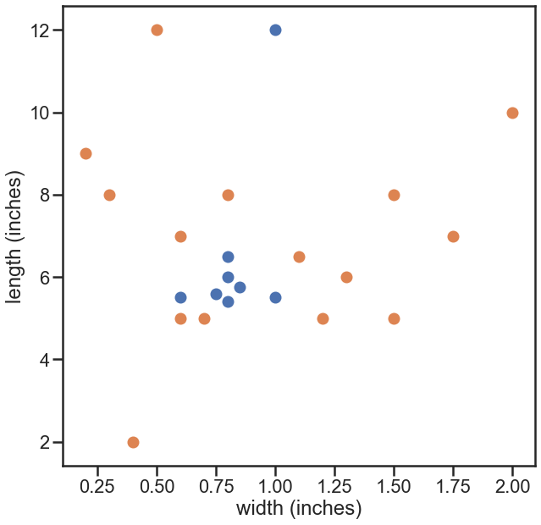
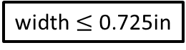

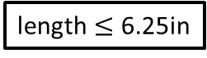
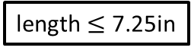
Hot Dog or Not
yes
no
yes
no
yes
no
yes
no

Slide 57
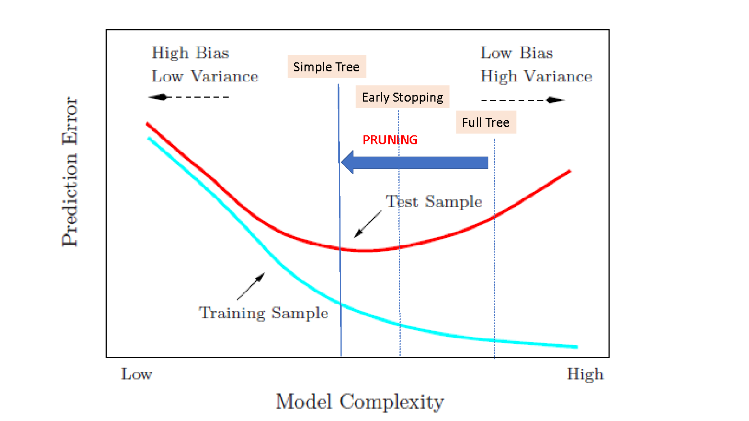
Motivation for Pruning

Slide 58
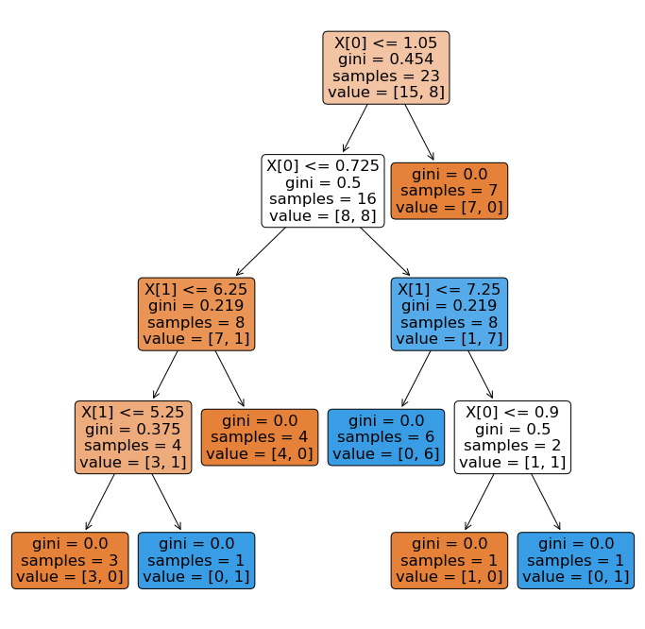
Motivation for Pruning

Slide 59
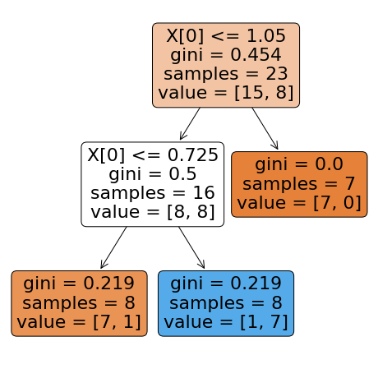
Motivation for Pruning

Slide 60
Motivation for Pruning

Slide 61
Please download and install the Slido app on all computers you use
Audience Q&A Session
ⓘ Start presenting to display the audience questions on this slide.

Slide 62
Outline
Motivation
Decision Trees
Splitting Criteria
Stopping Conditions & Pruning
Regression Trees
Random Forrest

Slide 63
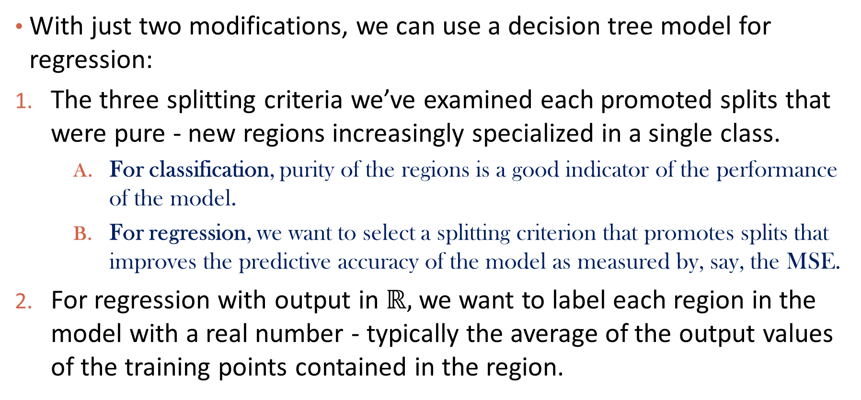
Adaptations for Regression

Slide 64
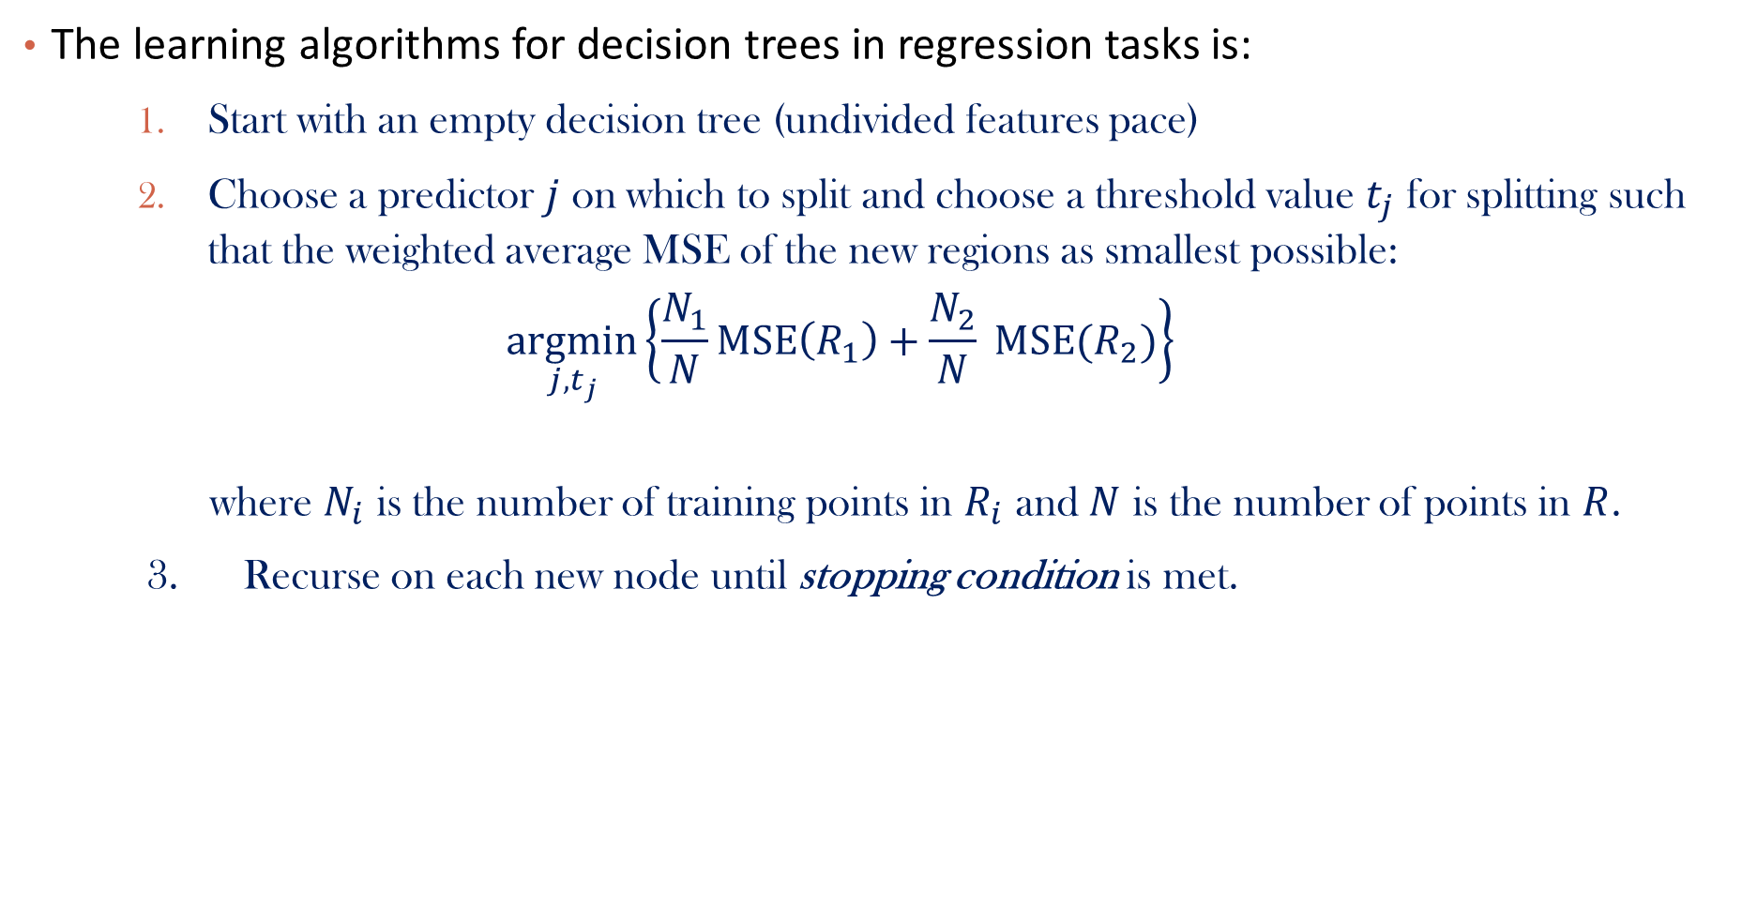
Learning Regression Trees

Slide 65
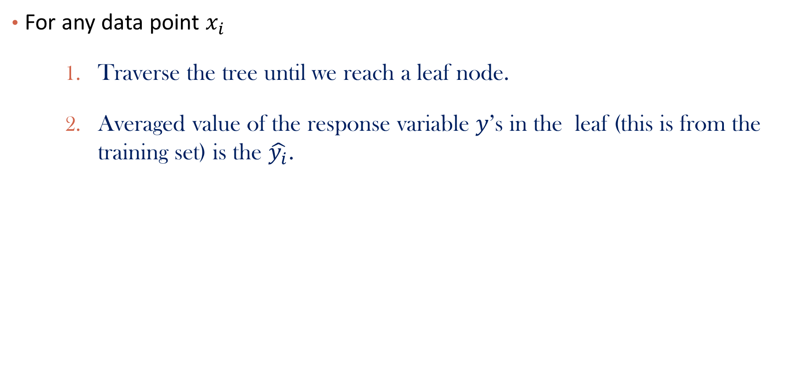
Regression Trees Prediction

Slide 66
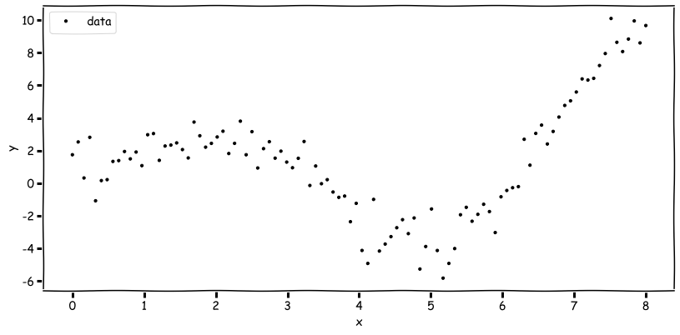
Regression Tree Example
How do we decide a split here?

Slide 67
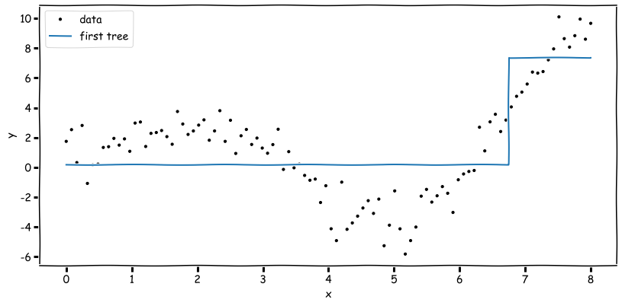
Regression Tree (max_depth = 1)

Slide 68
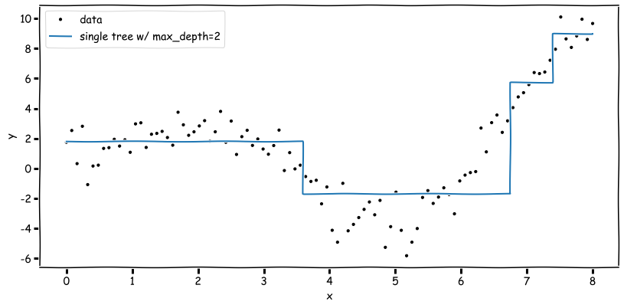
Regression Tree (max_depth = 2)

Slide 69
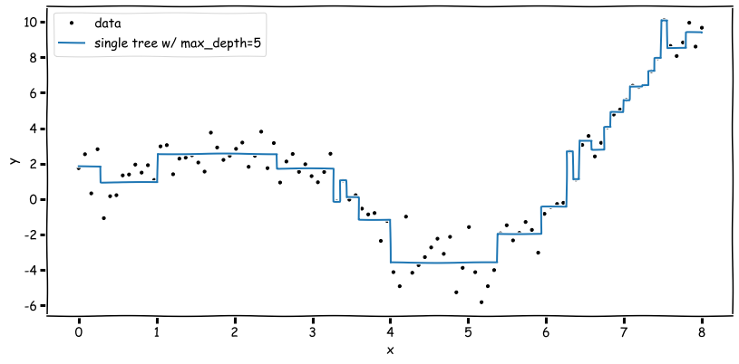
Regression Tree (max_depth = 5)

Slide 70
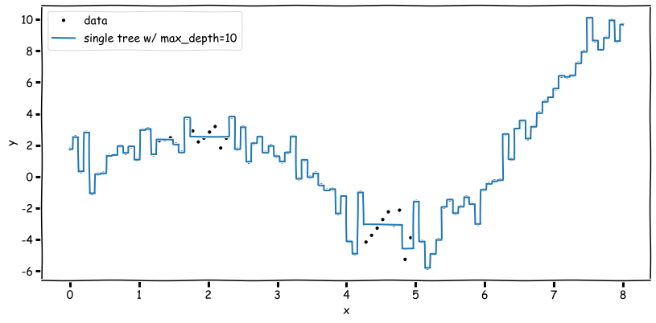
Regression Tree (max_depth = 10)

Slide 71
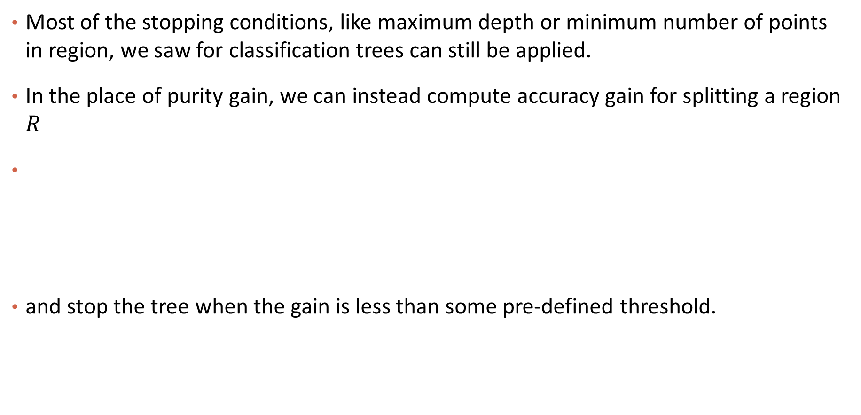
Stopping Conditions

Slide 72
Overfitting
Same issues as with classification trees. Avoid overfitting by pruning or limiting the depth of the tree and using CV.

Slide 73
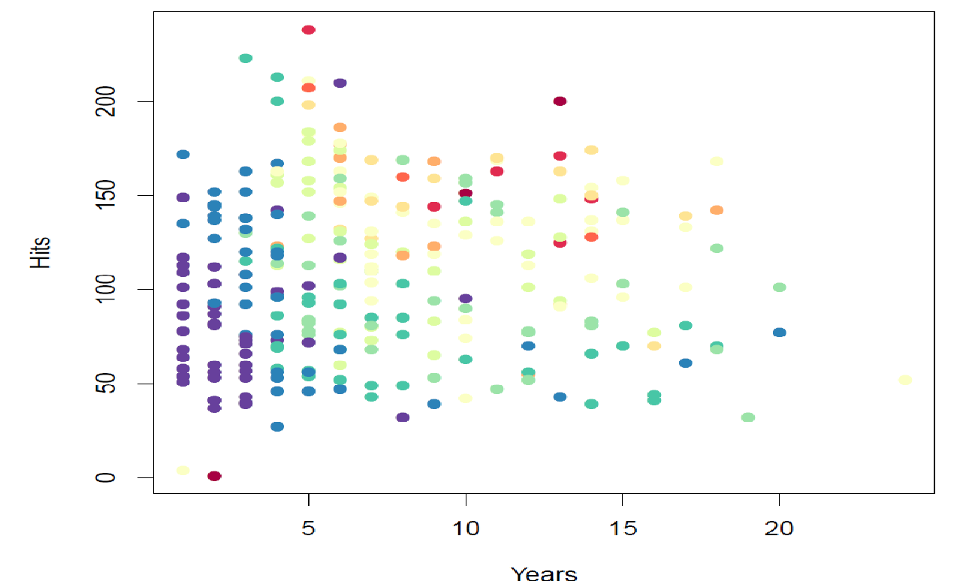
Example: Predict Baseball Player Salary
Dataset: (years, hits)=>Salary
Colors indicate value of salary (blue: low, red: high)

Slide 74
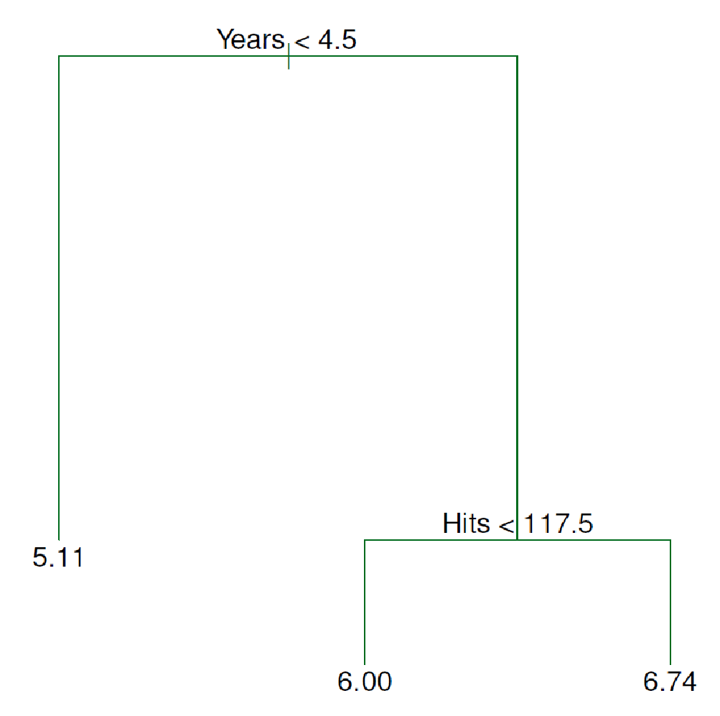
A Regression Tree Built

Slide 75
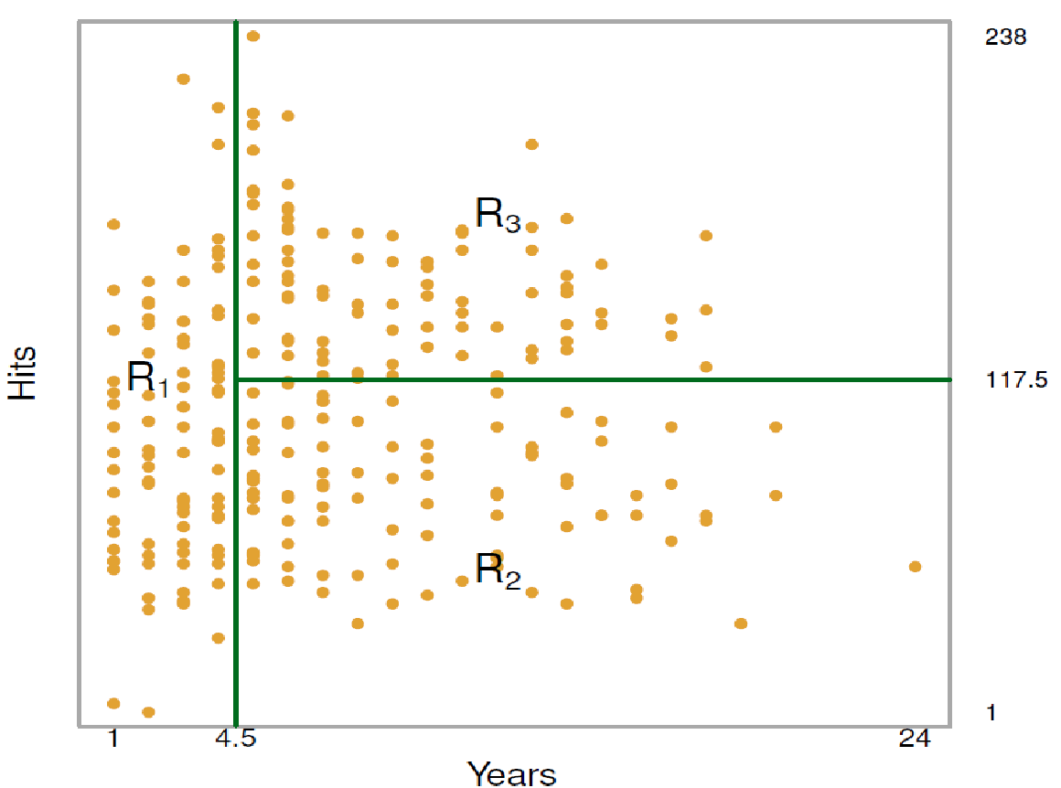
A Different Angle to View the Tree
A leaf is corresponding to a box in the plane
R3: Year > 4.5 & Hits >= 117.5
R1: Year < 4.5
R2: Year > 4.5 & Hits < 117.5

Slide 76
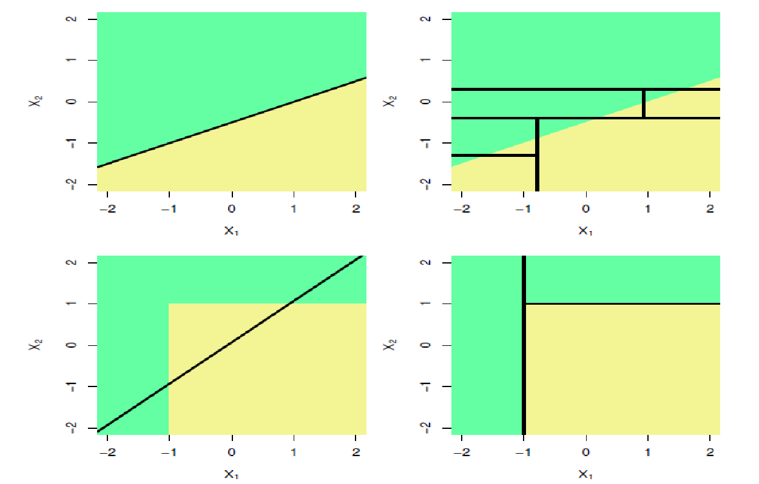
Trees vs. Linear Models
Ground Truth:
Linear Boundary
Ground Truth:
Non-Linear Boundary
Fitted Model:
Linear Model
Fitted Model:
Trees

Slide 77
Please download and install the Slido app on all computers you use
Audience Q&A Session
ⓘ Start presenting to display the audience questions on this slide.

Slide 78
Outline
Motivation
Decision Trees
Splitting Criteria
Stopping Conditions & Pruning
Regression Trees
Random Forrest

Slide 79
A Single Tree or a Set of Trees?
Limitation of single tree
Accuracy is not very high
Overfitting
A set of trees
The idea of ensemble

Slide 80
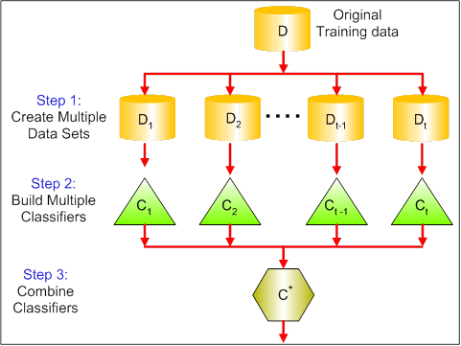
The Idea of Bagging
Bagging: Bootstrap Aggregating

Slide 81

*Why It Works?

Slide 82

Random Forest

Slide 83
Properties of Random Forest
Strengths
Good accuracy for classification tasks
Can handle large-scale of dataset
Can handle missing data to some extent
Weaknesses
Not so good for regression tasks
Lack of interpretation

Slide 84
Summary
Classification Trees
Predict categorical labels, splitting criterion, stopping criterion, pruning
Regression Trees
Predict numerical variable
Random Forest
A set of trees, bagging

